Slide 1
Quantitative techniques in computer design
Nilanjan Byabarta
UEM Kolkata

Slide 2
Agenda
* Sample questions on last Slide
measuring and reporting performance

Slide 3
Performance Measurement
Recall performance is function of
CPI: cycles per instruction
Clock cycle
Instruction count
Reducing any of the 3 factors will lead to improved performance

Slide 4
Computer performance is the amount of work accomplished by a computer system. The word performance in computer performance means “How well is the computer doing the work it is supposed to do?”. It basically depends on response time, throughput and execution time of a computer system.

Slide 5
Response time is the time from start to completion of a task. This also includes:
Operating system overhead.
Waiting for I/O and other processes
Accessing disk and memory
Time spent executing on the CPU or execution time.
Throughput is the total amount of work done in a given time.

Slide 6
CPU execution time is the total time a CPU spends computing on a given task. It also excludes time for I/O or running other programs. This is also referred to as simply CPU time.
Performance is determined by execution time as performance is inversely proportional to execution time.
Performance = (1 / Execution time)
And,
(Performance of A / Performance of B) = (Execution Time of B / Execution Time of A)

Slide 7
Execution time = CPU clock cycles x clock cycle time
Since clock cycle time and clock rate are reciprocals, so,
Execution time = CPU clock cycles / clock rate
The number of CPU clock cycles can be determined by,
CPU clock cycles = (No. of instructions / Program ) x (Clock cycles / Instruction) = Instruction Count x CPI

Slide 8
Execution time = Instruction Count x CPI x clock cycle time
= Instruction Count x CPI / clock rate
How to Improve Performance? To improve performance you can either:
Decrease the CPI (clock cycles per instruction) by using new Hardware.
Decrease the clock time or Increase clock rate by reducing propagation delays or by use pipelining.
Decrease the number of required cycles or improve ISA or Compiler.

Slide 9

A Few Words About Where We Are Headed
Performance = 1 / Execution time simplified to 1 / CPU execution time
CPU execution time = Instructions × CPI / (Clock rate)
Performance = Clock rate / ( Instructions × CPI )
Try to achieve CPI = 1 with clock that is as high as that for CPI > 1 designs; is CPI < 1 feasible?
Design hardware
for CPI = 1; seek improvements with CPI > 1
Define an instruction set;
make it simple enough
to require a small number
of cycles and allow high clock rate, but not so simple that we need many instructions, even for very simple tasks
Design memory & I/O structures to support ultrahigh-speed CPUs
Design ALU for arithmetic & logic ops

Slide 10
Performance Measurement
First step is to apply concept of pipelining to the instruction execution process
Overlap computations
What does this do?
Decrease clock cycle
Decrease effective CPU time compared to original clock cycle

Slide 11
Introduction
Principles that are useful in design and analysis of computers:
Make the common case fast !
If a design trade-off is necessary, favor the frequent case (which is often simpler) over the infrequent case.
For example, given that overflow in addition is infrequent, favor optimizing the case when no overflow occurs.

Slide 12
Introduction
Typical performance metrics:
Response time
Throughput
Speedup of X relative to Y
Execution time_{Y} / Execution time_{X}
Execution time
Wall clock time: includes all system overheads
CPU time: only computation time

Slide 13
Objective:
Determine the frequent case.
Determine how much improvement in performance is possible by making it faster.
Amdahl's law can be used to quantify the latter given that we have information concerning the former.

Slide 14

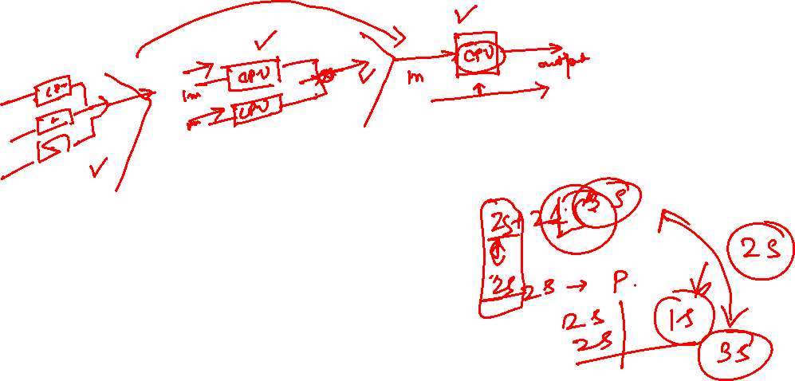
Amdahl's Law :
The performance improvement to be gained from using some faster mode of execution is limited by the fraction of the time the faster mode can be used.
Amdahl's law defines the speedup obtained by using a particular feature:

Slide 15
Areas of growth
Two factors:
Fraction _{enhanced} : Fraction of compute time in original machine that can be converted to take advantage of the enhancement.
Always <= 1.
Speedup _{enhanced} : Improvement gained by enhanced execution mode:
”

Slide 16
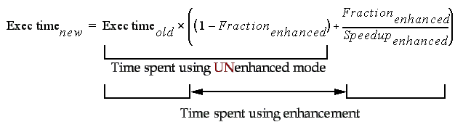
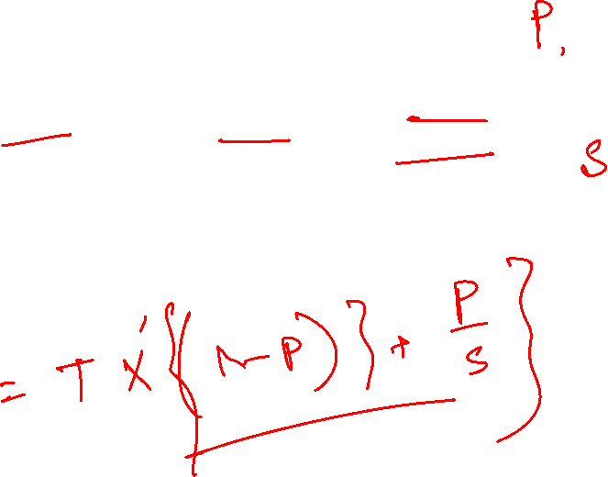
Execution time using original machine with enhancement:
”

Slide 17
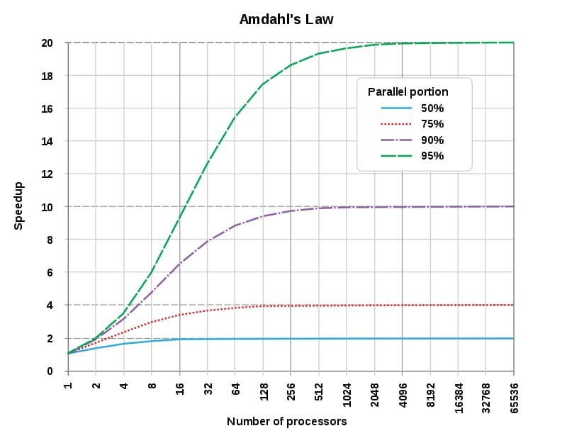
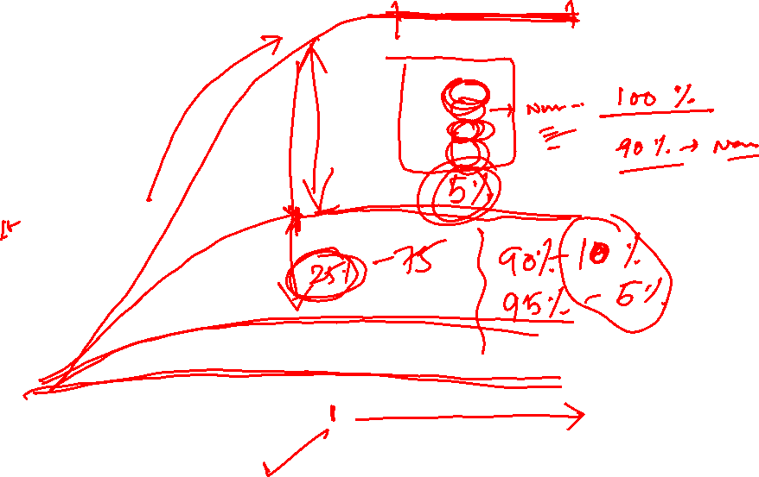

Slide 18
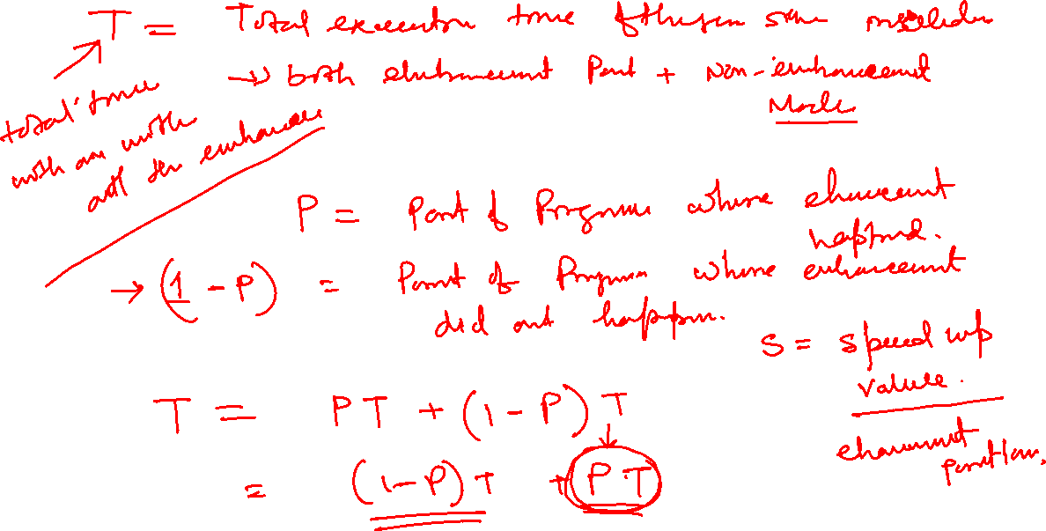

Slide 19
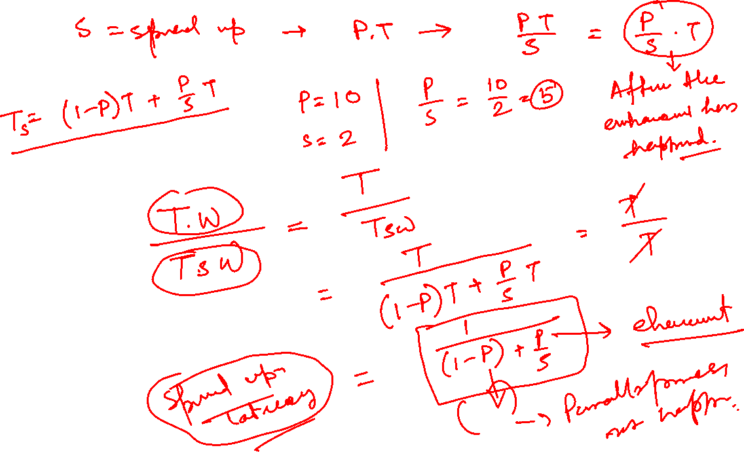

Slide 20
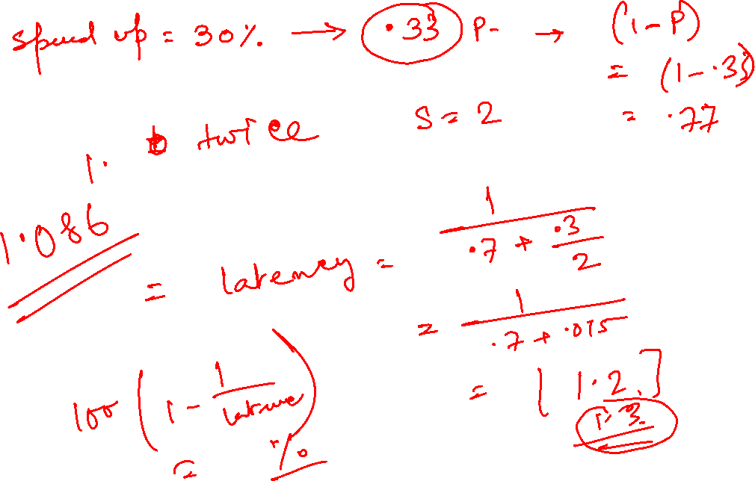

Slide 23
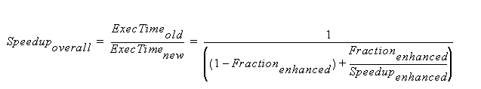

Speedup _{overall} using Amdahl's Law:

Slide 24
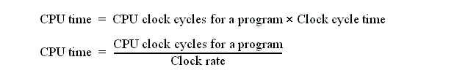
CPU Performance Equation:
Often it is difficult to measure the improvement in time using a new enhancement directly.
A second method that decomposes the CPU execution time into three components makes this task simpler.
CPU Performance Equation:
where, for example, Clock cycle time = 2ns for a 500MHz Clock rate.

Slide 25

CPU Performance Equation:
An alternative to "number of clock cycles" is "number of instructions executed" or Instruction Count ( IC ).
Given both the "number of clock cycles" and IC of a program, the average Clocks Per Instruction ( CPI ) is given by:

Slide 26

CPU Performance Equation:
One difficulty: It is difficult to change one in isolation of the others:
Clock cycle time: Hardware and Organization.
CPI: Organization and Instruction set architecture.
Instruction count: Instruction set architecture and Compiler technology.
where IC _{i} represents number of time instruction i is executed in a program and CPI _{i} represents the average number of clock cycles for instruction i.
Why isn't CPI _{i} a constant

Slide 27

(million instruction per second) is NOT an alternative metric to time.

Slide 28
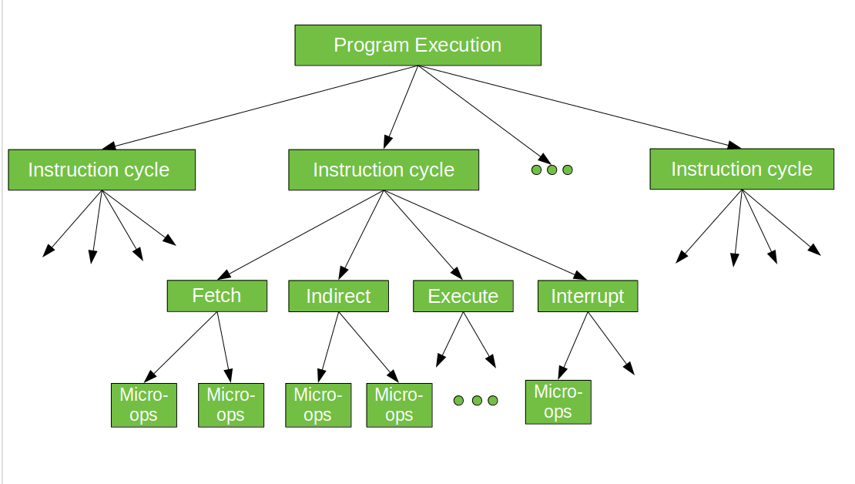
ISA(Instruction set Architecture)
In computer science, an instruction set architecture (ISA), also called computer architecture, is an abstract model of a computer. A device that executes instructions described by that ISA, such as a central processing unit (CPU), is called an implementation.

Slide 29
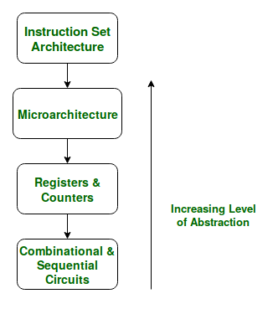
ISA describes the design of a Computer in terms of the basic operations it must support. The ISA is not concerned with the implementation-specific details of a computer. It is only concerned with the set or collection of basic operations the computer must support.

Slide 30
The ISA defines the types of instructions to be supported by the processor. Based on the type of operations they perform MIPS Instructions are classified into 3 types:
Arithmetic/Logic Instructions: These Instructions perform various Arithmetic & Logical operations on one or more operands.
Data Transfer Instructions: These instructions are responsible for the transfer of instructions from memory to the processor registers and vice versa.
Branch and Jump Instructions: These instructions are responsible for breaking the sequential flow of instructions and jumping to instructions at various other locations, this is necessary for the implementation of functions and conditional statements.

Slide 31
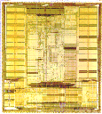
Instruction Set Architecture
Application
Instruction Set Architecture
…SPARC MIPS ARM x86 HP-PA IA-64…
Intel Pentium X
AMD K6, Athlon, Opteron
Transmeta Crusoe TM5x00
Implementation
31

Slide 32
Instruction Set Architecture
Strong influence on cost/performance
New ISAs are rare, but versions are not
16-bit, 32-bit and 64-bit X86 versions
Longevity is a strong function of marketing prowess

Slide 33
Traditional Issues
Strongly constrained by the number of bits available to instruction encoding
Opcodes/operands
Registers/memory
Addressing modes
Orthogonality
0, 1, 2, 3 address machines
Instruction formats
Decoding uniformity

Slide 34


Pipelining Concepts
Strategies for improving performance
1 – Use multiple independent data paths accepting several instructions
that are read out at once: multiple-instruction-issue or superscalar
2 – Overlap execution of several instructions, starting the next instruction
before the previous one has run to completion: (super)pipelined
2

Slide 35
Pipelined Instruction Execution

Slide 36
Alternate Representations of a Pipeline
Except for start-up and drainage overheads, a pipeline can execute one instruction per clock tick; IPS is dictated by the clock frequency

Slide 37
Alternate Representations of a Pipeline
Except for start-up and drainage overheads, a pipeline can execute one instruction per clock tick; IPS is dictated by the clock frequency

Slide 38
15.2 Pipeline Stalls or Bubbles
First type of data dependency

Slide 39
Writes into $8
Without data forwarding,
three bubbles are needed
to resolve a read-after-write
data dependency
Bubble
Bubble
Bubble
Reads from $8
Writes into $8
Two bubbles, if we assume that a register can be updated and read from in one cycle
Bubble
Bubble
Reads from $8

Slide 40
Second Type of Data Dependency
Without data forwarding, three (two) bubbles are needed to resolve a read-after-load data dependency
Read-after-load data dependency and its possible resolution through bubble insertion and data forwarding.

Slide 41
Introduction
A.1 What is Pipelining?
A.2 The Major Hurdle of Pipelining-Structural Hazards
Data Hazards
Control Hazards
A.3 How is Pipelining Implemented
A.4 What Makes Pipelining Hard to Implement?
A.5 Extending the MIPS Pipeline to Handle Multi-cycle Operations

Slide 42
What Is Pipelining
Laundry Example
Ann, Brian, Cathy, Dave each have one load of clothes to wash, dry, and fold
Washer takes 30 minutes
Dryer takes 40 minutes
“Folder” takes 20 minutes
A
B
C
D

Slide 43
What Is Pipelining
6 PM
7
8
9
10
11
Midnight
Time
30
40
20
30
40
20
30
40
20
30
40
20
T
a
s
k
O
r
d
e
r
A
B
C
D
Sequential laundry takes 6 hours for 4 loads
If they learned pipelining, how long would laundry take?

Slide 44
What Is Pipelining Start work ASAP
6 PM
7
8
9
10
11
Midnight
Time
30
40
40
40
40
20
T
a
s
k
O
r
d
e
r
A
Pipelined laundry takes 3.5 hours for 4 loads
B
C
D

Slide 45
Pipelining Lessons
What Is Pipelining
6 PM
7
8
9
Pipelining doesn’t help latency of single task, it helps throughput of entire workload
Pipeline rate limited by slowest pipeline stage
Multiple tasks operating simultaneously
Potential speedup = Number pipe stages
Unbalanced lengths of pipe stages reduces speedup
Time to “fill” pipeline and time to “drain” it reduces speedup
Time
T
a
s
k
O
r
d
e
r
30
40
40
40
40
20
A
B
C
D

Slide 46
MIPS Without Pipelining
What Is Pipelining
Instruction
Fetch
Instr. Decode
Reg. Fetch
Execute
Addr. Calc
Memory
Access
Write
Back
IR
L
M
D

Slide 47
MIPS Functions
What Is Pipelining
Instruction
Fetch
Instr. Decode
Reg. Fetch
Execute
Addr. Calc
Memory
Access
Write
Back
Passed To Next Stage
IR <- Mem[PC]
NPC <- PC + 4
IR
L
M
D
Instruction Fetch (IF):
Send out the PC and fetch the instruction from memory into the instruction register (IR); increment the PC by 4 to address the next sequential instruction.
IR holds the instruction that will be used in the next stage.
NPC holds the value of the next PC.

Slide 48
MIPS Functions
What Is Pipelining
Instruction
Fetch
Instr. Decode
Reg. Fetch
Execute
Addr. Calc
Memory
Access
Write
Back
Passed To Next Stage
A <- Regs[IR6..IR10];
B <- Regs[IR10..IR15];
Imm <- ((IR16) ##IR16-31
IR
L
M
D
Instruction Decode/Register Fetch Cycle (ID):
Decode the instruction and access the register file to read the registers.
The outputs of the general purpose registers are read into two temporary registers (A & B) for use in later clock cycles.
We extend the sign of the lower 16 bits of the Instruction Register.

Slide 49
MIPS Functions
What Is Pipelining
Instruction
Fetch
Instr. Decode
Reg. Fetch
Execute
Addr. Calc
Memory
Access
Write
Back
Passed To Next Stage
A <- A func. B
cond = 0;
IR
L
M
D
Execute Address Calculation (EX):
We perform an operation (for an ALU) or an address calculation (if it’s a load or a Branch).
If an ALU, actually do the operation. If an address calculation, figure out how to obtain the address and stash away the location of that address for the next cycle.

Slide 50
MIPS Functions
What Is Pipelining
Instruction
Fetch
Instr. Decode
Reg. Fetch
Execute
Addr. Calc
Memory
Access
Write
Back
Passed To Next Stage
A = Mem[prev. B]
or
Mem[prev. B] = A
IR
L
M
D
MEMORY ACCESS (MEM):
If this is an ALU, do nothing.
If a load or store, then access memory.

Slide 51
MIPS Functions
What Is Pipelining
Instruction
Fetch
Instr. Decode
Reg. Fetch
Execute
Addr. Calc
Memory
Access
Write
Back
Passed To Next Stage
Regs <- A, B;
IR
L
M
D
WRITE BACK (WB):
Update the registers from either the ALU or from the data loaded.

Slide 52
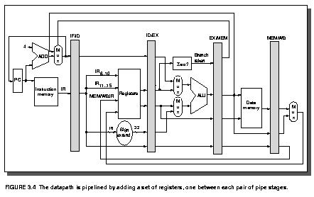
The Basic Pipeline For MIPS
Latches between each stage provide pipelining.

Slide 53
The Basic Pipeline For MIPS
Cycle 1
Cycle 2
Cycle 3
Cycle 4
Cycle 5
Cycle 6
Cycle 7
I
n
s
t
r.
O
r
d
e
r
Ifetch
Reg
ALU
DMem
Reg
Ifetch
Reg
ALU
DMem
Reg
Ifetch
Reg
ALU
DMem
Reg
Ifetch
Reg
ALU
DMem
Reg
Figure 3.3

Slide 54
Pipeline Hurdles
A.1 What is Pipelining?
A.2 The Major Hurdle of Pipelining-Structural Hazards
-- Structural Hazards
Data Hazards
Control Hazards
A.3 How is Pipelining Implemented
A.4 What Makes Pipelining Hard to Implement?
A.5 Extending the MIPS Pipeline to Handle Multi-cycle Operations
Limits to pipelining: Hazards prevent next instruction from executing during its designated clock cycle
Structural hazards: HW cannot support this combination of instructions (single person to fold and put clothes away)
Data hazards: Instruction depends on result of prior instruction still in the pipeline (missing sock)
Control hazards: Pipelining of branches & other instructions that change the PC
Common solution is to stall the pipeline until the hazard is resolved, inserting one or more “bubbles” in the pipeline

Slide 55
Pipeline Hurdles
Definition
conditions that lead to incorrect behavior if not fixed
Structural hazard
two different instructions use same h/w in same cycle
Data hazard
two different instructions use same storage
must appear as if the instructions execute in correct order
Control hazard
one instruction affects which instruction is next
Resolution
Pipeline interlock logic detects hazards and fixes them
simple solution: stall ­
increases CPI, decreases performance
better solution: partial stall ­
some instruction stall, others proceed better to stall early than late

Slide 56
Structural Hazards
Time (clock cycles)
When two or more different instructions want to use same hardware resource in same cycle
e.g., MEM uses the same memory port as IF as shown in this slide.
Cycle 1
Cycle 2
Cycle 3
Cycle 4
Cycle 5
Cycle 6
Cycle 7
I
n
s
t
r.
O
r
d
e
r
Load
Ifetch
Reg
ALU
DMem
Reg
Instr 1
Ifetch
Reg
ALU
DMem
Reg
Instr 2
Ifetch
Reg
ALU
DMem
Reg
Instr 3
Ifetch
Reg
ALU
DMem
Reg
Instr 4
Ifetch
Reg
ALU
DMem
Reg

Slide 57
Structural Hazards
Time (clock cycles)
Cycle 1
Cycle 2
Cycle 3
Cycle 4
Cycle 5
Cycle 6
Cycle 7
This is another way of looking at the effect of a stall.
I
n
s
t
r.
O
r
d
e
r
Load
Ifetch
Reg
ALU
DMem
Reg
Instr 1
Ifetch
Reg
ALU
DMem
Reg
Instr 2
Ifetch
Reg
ALU
DMem
Reg
Stall
Bubble
Bubble
Bubble
Bubble
Bubble
Instr 3
Ifetch
Reg
ALU
DMem
Reg

Slide 58
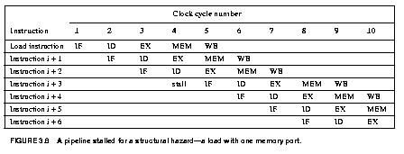
Structural Hazards
This is another way to represent the stall we saw on the last few pages.

Slide 59
Structural Hazards
Dealing with Structural Hazards
Stall
low cost, simple
Increases CPI
use for rare case since stalling has performance effect
Pipeline hardware resource
useful for multi-cycle resources
good performance
sometimes complex e.g., RAM
Replicate resource
good performance
increases cost (+ maybe interconnect delay)
useful for cheap or divisible resources

Slide 60
Structural Hazards
Structural hazards are reduced with these rules:
Each instruction uses a resource at most once
Always use the resource in the same pipeline stage
Use the resource for one cycle only
Many RISC ISA’a designed with this in mind
Sometimes very complex to do this. For example, memory of necessity is used in the IF and MEM stages.
Some common Structural Hazards:
Memory - we’ve already mentioned this one.
Floating point - Since many floating point instructions require many cycles, it’s easy for them to interfere with each other.
Starting up more of one type of instruction than there are resources. For instance, the PA-8600 can support two ALU + two load/store instructions per cycle - that’s how much hardware it has available.

Slide 61
Data Hazards
A.1 What is Pipelining?
A.2 The Major Hurdle of Pipelining-Structural Hazards
-- Structural Hazards
Data Hazards
Control Hazards
A.3 How is Pipelining Implemented
A.4 What Makes Pipelining Hard to Implement?
A.5 Extending the MIPS Pipeline to Handle Multi-cycle Operations
These occur when at any time, there are instructions active that need to access the same data (memory or register) locations.
Where there’s real trouble is when we have:
instruction A
instruction B
and B manipulates (reads or writes) data before A does. This violates the order of the instructions, since the architecture implies that A completes entirely before B is executed.

Slide 62
Data Hazards
Execution Order is:
Instr_{I}
Instr_{J}
Read After Write (RAW) Instr_{J} tries to read operand before Instr_{I} writes it
Caused by a “Dependence” (in compiler nomenclature). This hazard results from an actual need for communication.
I: add r1,r2,r3
J: sub r4,r1,r3

Slide 63
Data Hazards
Execution Order is:
Instr_{I}
Instr_{J}
Write After Read (WAR) Instr_{J} tries to write operand before Instr_{I} reads i
Gets wrong operand
Called an “anti-dependence” by compiler writers. This results from reuse of the name “r1”.
Can’t happen in MIPS 5 stage pipeline because:
All instructions take 5 stages, and
Reads are always in stage 2, and
Writes are always in stage 5
I: sub r4,r1,r3
J: add r1,r2,r3
K: mul r6,r1,r7

Slide 64
Data Hazards
Execution Order is:
Instr_{I}
Instr_{J}
Write After Write (WAW) Instr_{J} tries to write operand before Instr_{I} writes it
Leaves wrong result ( Instr_{I} not Instr_{J} )
Called an “output dependence” by compiler writers This also results from the reuse of name “r1”.
Can’t happen in MIPS 5 stage pipeline because:
All instructions take 5 stages, and
Writes are always in stage 5
Will see WAR and WAW in later more complicated pipes
I: sub r1,r4,r3
J: add r1,r2,r3
K: mul r6,r1,r7

Slide 65
Data Hazards
Simple Solution to RAW
Hardware detects RAW and stalls
Assumes register written then read each cycle
+ low cost to implement, simple
-- reduces IPC
Try to minimize stalls
Minimizing RAW stalls
Bypass/forward/short­circuit (We will use the word “forward”)
Use data before it is in the register
+ reduces/avoids stalls
-- complex
Crucial for common RAW hazards

Slide 66
Data Hazards
Time (clock cycles)
IF
ID/RF
EX
MEM
WB
I
n
s
t
r.
O
r
d
e
r
add r1,r2,r3
Ifetch
Reg
ALU
DMem
Reg
sub r4,r1,r3
Ifetch
Reg
ALU
DMem
Reg
and r6,r1,r7
Ifetch
Reg
ALU
DMem
Reg
or r8,r1,r9
Ifetch
Reg
ALU
DMem
Reg
xor r10,r1,r11
Ifetch
Reg
ALU
DMem
Reg
The use of the result of the ADD instruction in the next three instructions causes a hazard, since the register is not written until after those instructions read it.

Slide 67
Data Hazards
Forwarding is the concept of making data available to the input of the ALU for subsequent instructions, even though the generating instruction hasn’t gotten to WB in order to write the memory or registers.
Forwarding To Avoid
Data Hazard
Time (clock cycles)
I
n
s
t
r.
O
r
d
e
r
add r1,r2,r3
Ifetch
Reg
ALU
DMem
Reg
sub r4,r1,r3
Ifetch
Reg
ALU
DMem
Reg
and r6,r1,r7
Ifetch
Reg
ALU
DMem
Reg
or r8,r1,r9
Ifetch
Reg
ALU
DMem
Reg
xor r10,r1,r11
Ifetch
Reg
ALU
DMem
Reg

Slide 68
Data Hazards
The data isn’t loaded until after the MEM stage.
Time (clock cycles)
I
n
s
t
r.
O
r
d
e
r
lw r1, 0(r2)
Ifetch
Reg
ALU
DMem
Reg
sub r4,r1,r6
Ifetch
Reg
ALU
DMem
Reg
and r6,r1,r7
Ifetch
Reg
ALU
DMem
Reg
or r8,r1,r9
Ifetch
Reg
ALU
DMem
Reg
There are some instances where hazards occur, even with forwarding.

Slide 69
Data Hazards
The stall is necessary as shown here.
Time (clock cycles)
I
n
s
t
r.
O
r
d
e
r
lw r1, 0(r2)
Ifetch
Reg
ALU
DMem
Reg
Bubble
sub r4,r1,r6
Ifetch
Reg
ALU
DMem
Reg
Bubble
and r6,r1,r7
Ifetch
Reg
ALU
DMem
Reg
Bubble
or r8,r1,r9
Ifetch
Reg
ALU
DMem
There are some instances where hazards occur, even with forwarding.

Slide 70
Data Hazards
This is another representation of the stall.
LW R1, 0(R2) | IF | ID | EX | MEM | WB
SUB R4, R1, R5 |  | IF | ID | EX | MEM | WB
AND R6, R1, R7 |  |  | IF | ID | EX | MEM | WB
OR R8, R1, R9 |  |  |  | IF | ID | EX | MEM | WB
LW R1, 0(R2) | IF | ID | EX | MEM | WB
SUB R4, R1, R5 |  | IF | ID | stall | EX | MEM | WB
AND R6, R1, R7 |  |  | IF | stall | ID | EX | MEM | WB
OR R8, R1, R9 |  |  |  | stall | IF | ID | EX | MEM | WB

Slide 71
Data Hazards
Pipeline Scheduling
Instruction scheduled by compiler - move instruction in order to reduce stall.
lw Rb, b ­­ code sequence for a = b+c before scheduling
lw Rc, c
Add Ra, Rb, Rc ­­ stall
sw a, Ra
lw Re, e ­­ code sequence for d = e+f before scheduling
lw Rf, f
sub Rd, Re, Rf ­­ stall
sw d, Rd
Arrangement of code after scheduling.
lw Rb, b
lw Rc, c
lw Re, e
Add Ra, Rb, Rc
lw Rf, f
sw a, Ra
sub Rd, Re, Rf
sw d, Rd

Slide 72
Data Hazards
Pipeline Scheduling

Slide 73
Control Hazards
A.1 What is Pipelining?
A.2 The Major Hurdle of Pipelining-Structural Hazards
-- Structural Hazards
Data Hazards
Control Hazards
A.3 How is Pipelining Implemented
A.4 What Makes Pipelining Hard to Implement?
A.5 Extending the MIPS Pipeline to Handle Multi-cycle Operations
A control hazard is when we need to find the destination of a branch, and can’t fetch any new instructions until we know that destination.

Slide 74
Control Hazard on Branches Three Stage Stall
Control Hazards
10: beq r1,r3,36
Ifetch
Reg
ALU
DMem
Reg
14: and r2,r3,r5
Ifetch
Reg
ALU
DMem
Reg
18: or r6,r1,r7
Ifetch
Reg
ALU
DMem
Reg
22: add r8,r1,r9
Ifetch
Reg
ALU
DMem
Reg
36: xor r10,r1,r11
Ifetch
Reg
ALU
DMem
Reg

Slide 75
Branch Stall Impact
Control Hazards
If CPI = 1, 30% branch, Stall 3 cycles => new CPI = 1.9!
(Whoa! How did we get that 1.9???)
Two part solution to this dramatic increase:
Determine branch taken or not sooner, AND
Compute taken branch address earlier
MIPS branch tests if register = 0 or ^ 0
MIPS Solution:
Move Zero test to ID/RF stage
Adder to calculate new PC in ID/RF stage
must be fast
can't afford to subtract
compares with 0 are simple
Greater-than, Less-than test sign­bit, but not-equal must OR all bits
more general compares need ALU
1 clock cycle penalty for branch versus 3
In the next chapter, we’ll look at ways to avoid the branch all together.

Slide 76
Five Branch Hazard Alternatives
Control Hazards
#1: Stall until branch direction is clear
#2: Predict Branch Not Taken
Execute successor instructions in sequence
“Squash” instructions in pipeline if branch actually taken
Advantage of late pipeline state update
47% MIPS branches not taken on average
PC+4 already calculated, so use it to get next instruction
#3: Predict Branch Taken
53% MIPS branches taken on average
But haven’t calculated branch target address in MIPS
MIPS still incurs 1 cycle branch penalty
Other machines: branch target known before outcome

Slide 77
Control Hazards
Five Branch Hazard Alternatives
#4: Execute Both Paths
#5: Delayed Branch
Define branch to take place AFTER a following instruction
branch instruction sequential successor₁ sequential successor₂ ........ sequential successor_{n}
branch target if taken
1 slot delay allows proper decision and branch target address in 5 stage pipeline
MIPS uses this
Branch delay of length n

Slide 78
Delayed Branch
Control Hazards
Where to get instructions to fill branch delay slot?
Before branch instruction
From the target address: only valuable when branch taken
From fall through: only valuable when branch not taken
Cancelling branches allow more slots to be filled
Compiler effectiveness for single branch delay slot:
Fills about 60% of branch delay slots
About 80% of instructions executed in branch delay slots useful in computation
About 50% (60% x 80%) of slots usefully filled
Delayed Branch downside: 7-8 stage pipelines, multiple instructions issued per clock (superscalar)

Slide 79
Evaluating Branch Alternatives
Control Hazards
Scheduling Branch CPI speedup v. Speedup v.
scheme penalty unpipelined stall
Stall pipeline 3 1.42 3.5 1.0
Predict taken 1 1.14 4.4 1.26
Predict not taken 1 1.09 4.5 1.29
Delayed branch 0.5 1.07 4.6 1.31
Conditional & Unconditional = 14%, 65% change PC

Slide 80
Pipelining Introduction Summary
Control Hazards
Just overlap tasks, and easy if tasks are independent
Speed Up Š Pipeline Depth; if ideal CPI is 1, then:
Hazards limit performance on computers:
Structural: need more HW resources
Data (RAW,WAR,WAW): need forwarding, compiler scheduling
Control: delayed branch, prediction
Pipeline Depth
Clock Cycle Unpipelined
Speedup =
X
1 + Pipeline stall CPI
Clock Cycle Pipelined

Slide 81
Compiler “Static” Prediction of Taken/Untaken Branches
Control Hazards
The compiler can program what it thinks the branch direction will be. Here are the results when it does so.
Always taken
Taken backwards
Not Taken Forwards

Slide 82
Compiler “Static” Prediction of Taken/Untaken Branches
Control Hazards
Improves strategy for placing instructions in delay slot
Two strategies
Backward branch predict taken, forward branch not taken
Profile-based prediction: record branch behavior, predict branch based on prior run

Slide 83
Evaluating Static Branch Prediction Strategies
Control Hazards
Misprediction ignores frequency of branch
“Instructions between mispredicted branches” is a better metric

Slide 84
What Makes Pipelining Hard?
A.1 What is Pipelining?
A.2 The Major Hurdle of Pipelining-Structural Hazards
Data Hazards
Control Hazards
A.3 How is Pipelining Implemented
A.4 What Makes Pipelining Hard to Implement?
A.5 Extending the MIPS Pipeline to Handle Multi-cycle Operations

Slide 85
What Makes Pipelining Hard?
Interrupts cause great havoc!
Examples of interrupts:
Power failing,
Arithmetic overflow,
I/O device request,
OS call,
Page fault
Interrupts (also known as: faults, exceptions, traps) often require
surprise jump (to vectored address)
linking return address
saving of PSW (including CCs)
state change (e.g., to kernel mode)
There are 5 instructions executing in 5 stage pipeline when an interrupt occurs:
How to stop the pipeline?
How to restart the pipeline?
Who caused the interrupt?

Slide 86
What Makes Pipelining Hard?
Interrupts cause great havoc!
What happens on interrupt while in delay slot ?
Next instruction is not sequential
solution #1: save multiple PCs
Save current and next PC
Special return sequence, more complex hardware
solution #2: single PC plus
Branch delay bit
PC points to branch instruction
Stage Problem that causes the interrupt
IF Page fault on instruction fetch; misaligned memory access; memory-protection violation
ID Undefined or illegal opcode
EX Arithmetic interrupt
MEM Page fault on data fetch; misaligned memory access; memory-protection violation

Slide 87
What Makes Pipelining Hard?
Interrupts cause great havoc!
Simultaneous exceptions in more than one pipeline stage, e.g.,
Load with data page fault in MEM stage
Add with instruction page fault in IF stage
Add fault will happen BEFORE load fault
Solution #1
Interrupt status vector per instruction
Defer check until last stage, kill state update if exception
Solution #2
Interrupt ASAP
Restart everything that is incomplete
Another advantage for state update late in pipeline!

Slide 88
What Makes Pipelining Hard?
Interrupts cause great havoc!
Here’s what happens on a data page fault.
1 2 3 4 5 6 7 8 9
i F D X M W
i+1 F D X M W <­ page fault
i+2 F D X M W <­ squash
i+3 F D X M W <­ squash
i+4 F D X M W <­ squash
i+5 trap ­> F D X M W
i+6 trap handler ­> F D X M W

Slide 89
What Makes Pipelining Hard?
Complex Instructions
Complex Addressing Modes and Instructions
Address modes: Autoincrement causes register change during instruction execution
Interrupts? Need to restore register state
Adds WAR and WAW hazards since writes are no longer the last stage.
Memory-Memory Move Instructions
Must be able to handle multiple page faults
Long-lived instructions: partial state save on interrupt
Condition Codes

Slide 90
Handling Multi-cycle Operations
A.1 What is Pipelining?
A.2 The Major Hurdle of Pipelining-Structural Hazards
Data Hazards
Control Hazards
A.3 How is Pipelining Implemented
A.4 What Makes Pipelining Hard to Implement?
A.5 Extending the MIPS Pipeline to Handle Multi-cycle Operations
Multi-cycle instructions also lead to pipeline complexity.
A very lengthy instruction causes everything else in the pipeline to wait for it.

Slide 91
Multi-Cycle Operations
Floating Point
Floating point gives long execution time.
This causes a stall of the pipeline.
It’s possible to pipeline the FP execution unit so it can initiate new instructions without waiting full latency. Can also have multiple FP units.
FP Instruction Latency Initiation Rate
Add, Subtract 4 3
Multiply 8 4
Divide 36 35
Square root 112 111
Negate 2 1
Absolute value 2 1
FP compare 3 2

Slide 92
Floating Point
Multi-Cycle Operations
Divide, Square Root take ­10X to ­30X longer than Add
Interrupts?
Adds WAR and WAW hazards since pipelines are no longer same length
Notes:
I + 2: no WAW, but this complicates an interrupt
I + 4: no WB conflict
I + 5: stall forced by structural hazard
I + 6: stall forced by in-order issue

Slide 93
Summary of Pipelining Basics
Hazards limit performance
Structural: need more HW resources
Data: need forwarding, compiler scheduling
Control: early evaluation & PC, delayed branch, prediction
Increasing length of pipe increases impact of hazards; pipelining helps instruction bandwidth, not latency
Interrupts, Instruction Set, FP makes pipelining harder
Compilers reduce cost of data and control hazards
Load delay slots
Branch delay slots
Branch prediction

Slide 94
Summary
A.1 What is Pipelining?
A.2 The Major Hurdle of Pipelining-Structural Hazards
Data Hazards
Control Hazards
A.3 How is Pipelining Implemented
A.4 What Makes Pipelining Hard to Implement?
A.5 Extending the MIPS Pipeline to Handle Multi-cycle Operations

Slide 95
Define pipeline chaining
Illustrate thedifferences between dynamic pipeline and static pipeline
Define speedup. Is this speed up always achievable
Demonstrate different factors that can affect the performance of a pipelined system
Differentiate between WAR and RAW with a suitable example.
Evaluate what is meant by pipeline stall
Instruction execution throughput increases in proportion with the number of pipeline stages.” Is it true? Justify your statement.
Construct different approaches taken by pipeline processor to handle branch instructions
Demonstrate branch hazard
Discuss briefly two approaches to handle branch hazards.
State the major hurdles to achieve ideal speed-up
Discuss data hazard briefly.
Write short notes on the following : Pipeline hazards, Branch handling in instruction pipeline.
Explain static and dynamic pipeline with a proper diagram. State the differences between them
Define speedup. Deduce the equation to calculate maximum speed up. Analyze if maximum speed up is always achievable
Discuss the meaning of clock period of a pipeline.State the process to calculate the clock period of a pipeline
Discuss the meaning of frequency and throughput of a pipeline. Deduce the equation when maximum throughput is equal to the frequency of the pipeline.
Explain different techniques for resolving structural hazards.
"Explain how control hazard occurs while executing the following block of code:
10: BEQ R1,R3,36
16: AND R2,R3,R5
22: OR R6,R1,R7
28: ADD R8,R1,R9
36: XOR R10,R1,R11"
Discuss the meaning of operand forwarding and bypassing. State how does it help to solve RAW hazards. Explain with the help of a diagram.

